Slide 1
Day 2
DNA sequencing and coverage
Coffee break
Illumina sequencing
Lunch break
More Linux

Slide 2
Challenges of DNA sequencing and genome assembly
Do you remember?

Slide 3

Challenges of DNA sequencing and genome assembly
Big genomes
Heterozygous genomes
Polyploid genomes
Repeated DNA
Plant genomes are often big, heterozygous, polyploid, and rich in repeated DNA!

Slide 4

Challenges of DNA sequencing and genome assembly
Big genomes
Heterozygous genomes
Polyploid genomes
Repeated DNA
More data
Longer reads
Paired-end reads
Plant genomes are often big, heterozygous, polyploid, and rich in repeated DNA!

Slide 5
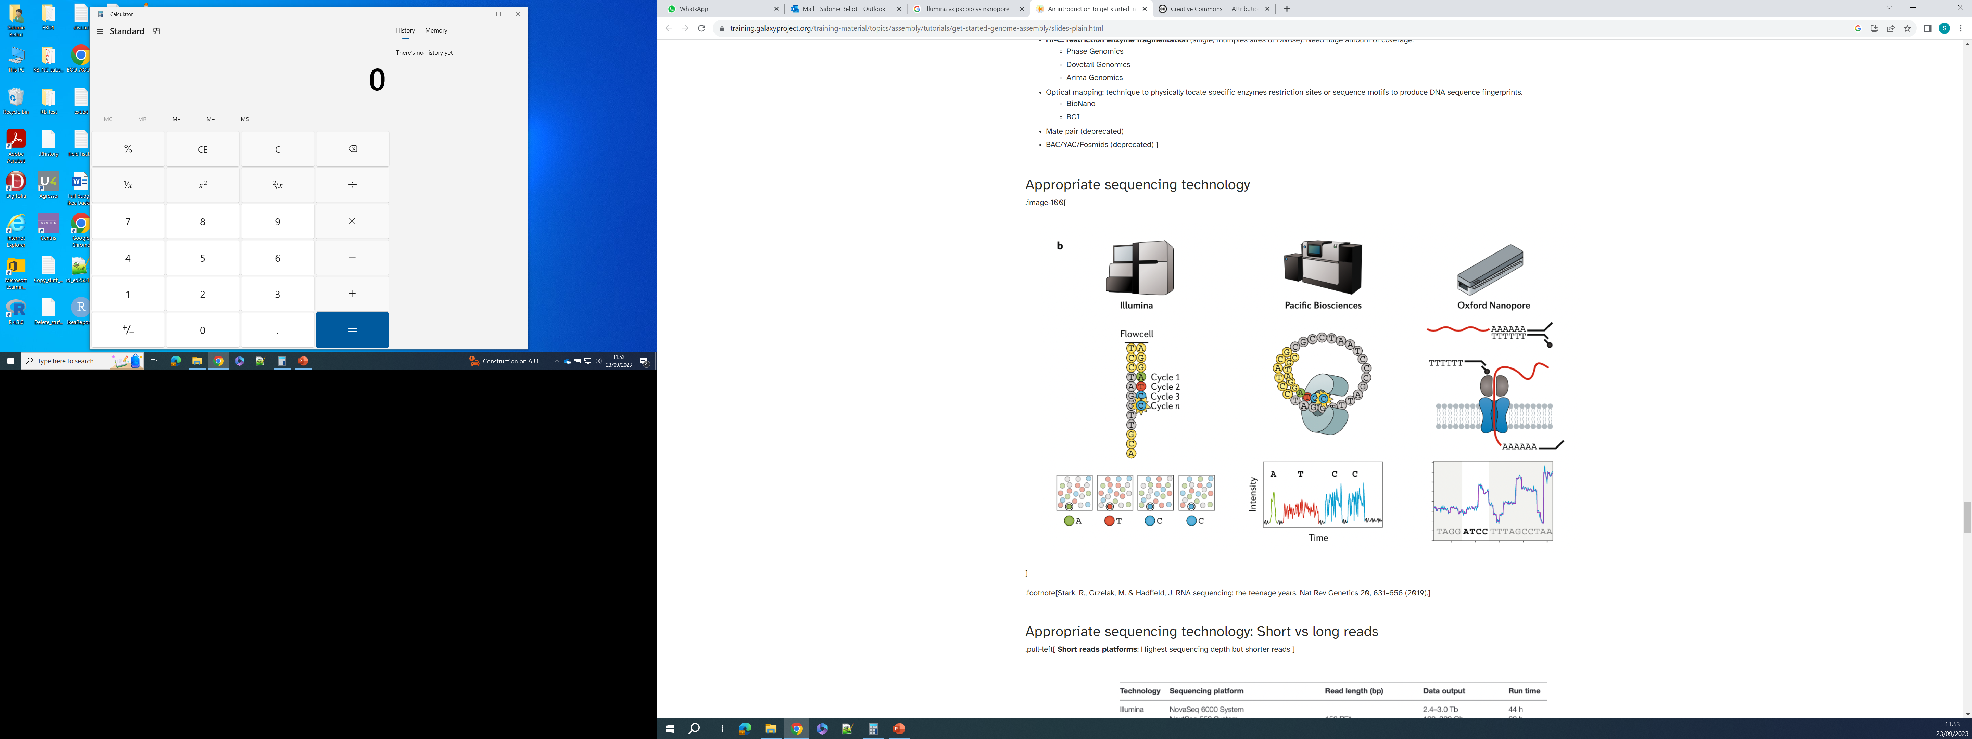
Short- vs Long-read sequencing
Short DNA fragments
(naturally degraded or fragmented on purpose)
1,000 bp
300 bp
100 bp
AAGG
ACCATTT
AGCA
ATGCT
TGCCAT
Short reads
50 – 600 bp
TTGCCA
ATAG
AAAC
TACCATTT

Slide 6
Short- vs Long-read sequencing
Short DNA fragments
(naturally degraded or fragmented on purpose)
1,000 bp
10,000 bp
Long DNA fragments
(naturally degraded)
300 bp
100 bp
100,000 bp
5,000 bp
TTGCAAAAGG
Long reads
5,000 – 2,000,000 bp
AAGGGCCCAATGCATCTA
AAGG
CTTCTTTTTTGCAA
ACCATTT
AGCA
AND/OR
ATGCT
TGCCAT
TTGCAA
Short reads
50 – 600 bp
Short reads
50 – 600 bp
TTGCCA
GCCCAA
AAGG
ATAG
AAAC
TACCATTT
TTTTG
CAA
TGCAT
CTTCTT

Slide 7
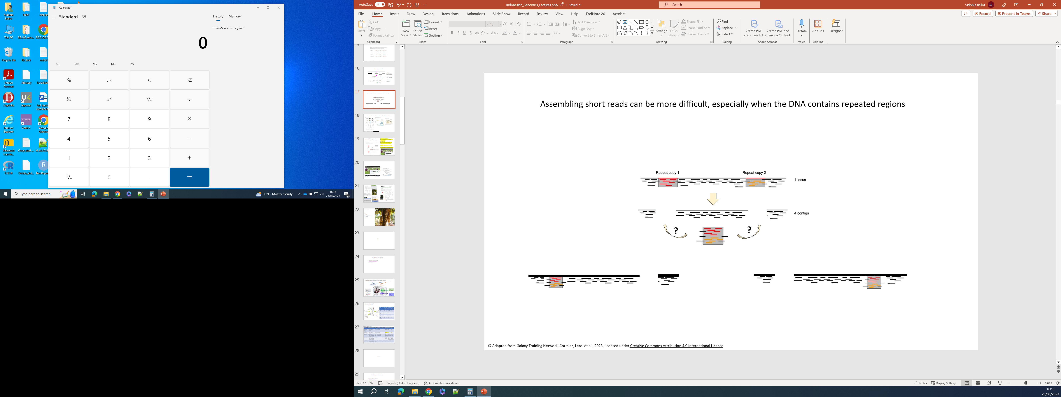
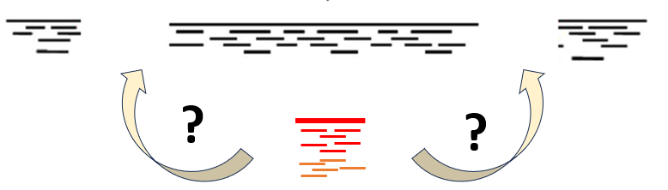
Reads longer than the repeat can help solving assemblies of complex regions
© Adapted from Galaxy Training Network, Cormier, Leroi et al., 2023, licensed under Creative Commons Attribution 4.0 International License

Slide 8
Reads longer than the repeat can help solving assemblies of complex regions
© Adapted from Galaxy Training Network, Cormier, Leroi et al., 2023, licensed under Creative Commons Attribution 4.0 International License

Slide 9
Paired-end sequencing can help solving assemblies of complex regions
Paired-end sequencing
DNA fragment being sequenced
500 bp in average
read 1
forward read
150 bp
read 2
reverse read
150 bp
© Adapted from Galaxy Training Network, Cormier, Leroi et al., 2023, licensed under Creative Commons Attribution 4.0 International License

Slide 10
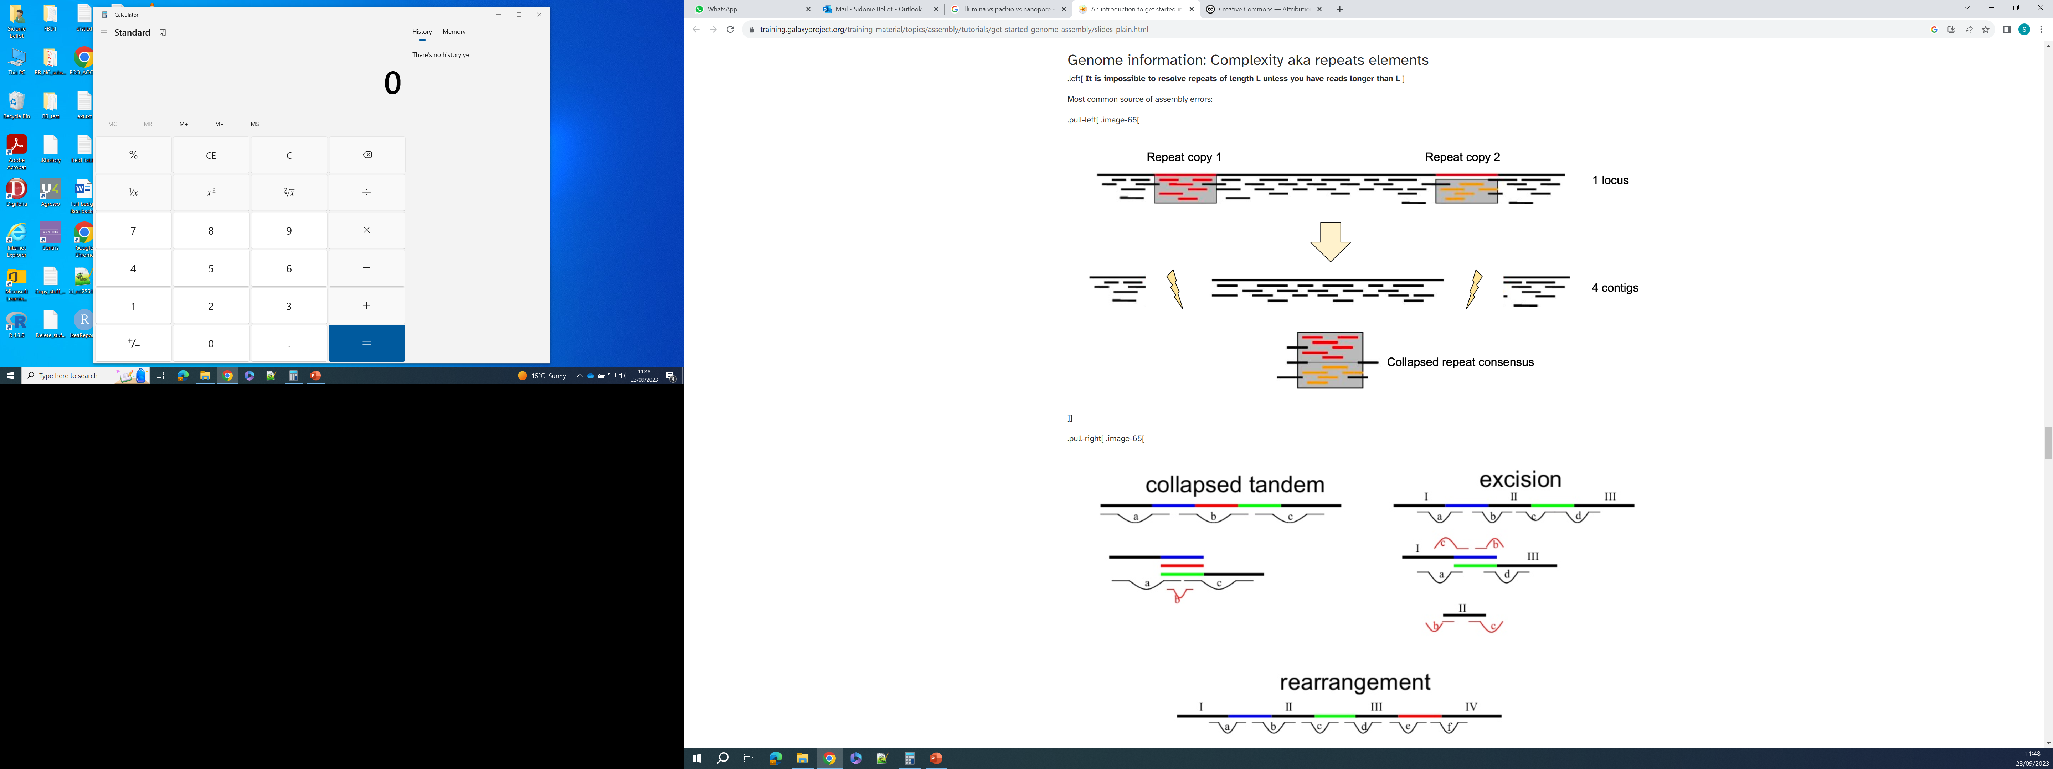
Paired-end sequencing can help solving assemblies of complex regions
Paired-end sequencing
DNA fragment being sequenced
500 bp in average
We know that read 1 and read 2 come from a same DNA fragment
And we know the average length of the DNA fragments
We know that the distance between read 1 and read 2
cannot be more than the DNA fragment size:
Read 1 and read 2 cannot be more than ~500 bp apart
read 1
forward read
150 bp
read 2
reverse read
150 bp
More than 500 bp between read 1 and read 2: this assembly is wrong!
read 1
read 2
This is the correct assembly
© Adapted from Galaxy Training Network, Cormier, Leroi et al., 2023, licensed under Creative Commons Attribution 4.0 International License

Slide 11
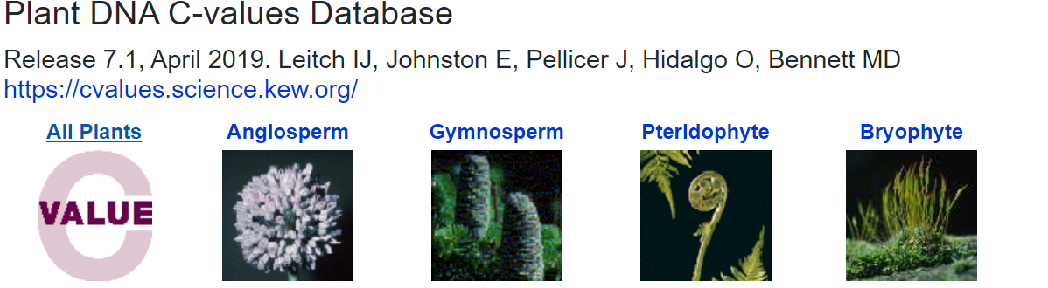
More data will enable better genome assemblies
The bigger the genome, the more sequencing is needed
We need to know the genome size to:
Plan the amount of sequencing needed
Estimate sequencing coverage (success)
© Adapted from Galaxy Training Network, Cormier, Leroi et al., 2023, licensed under Creative Commons Attribution 4.0 International License

Slide 12
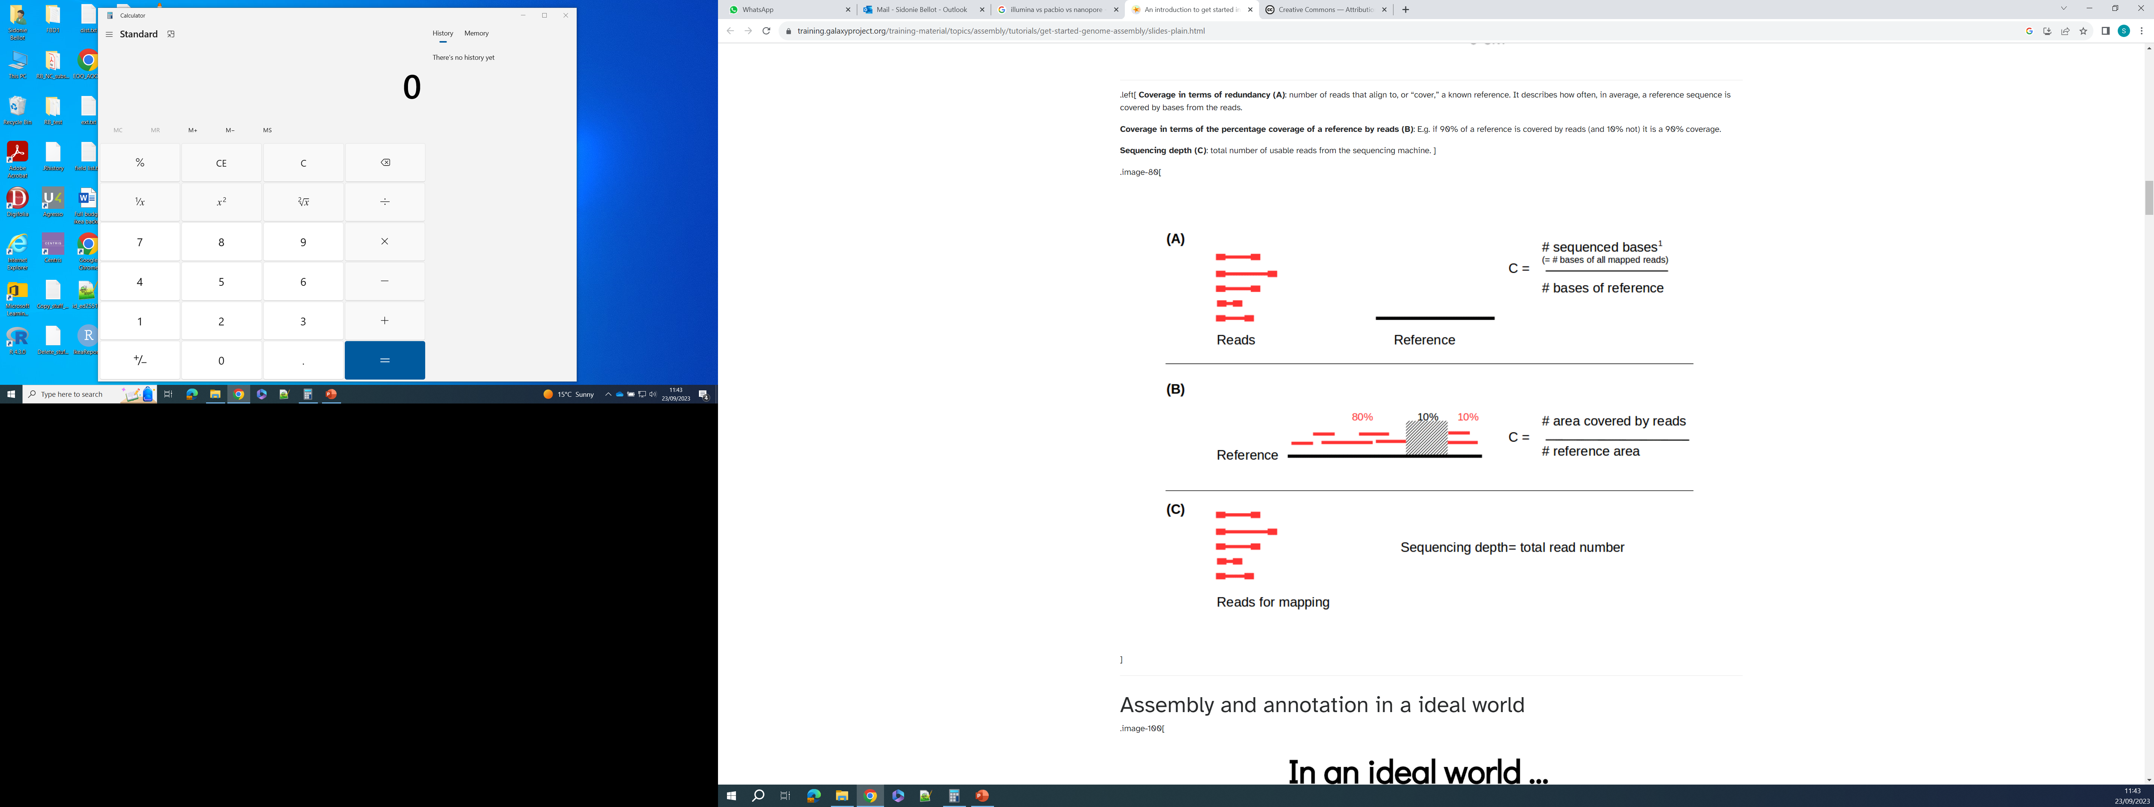
More data will enable better genome assemblies
The bigger the genome, the more sequencing is needed
We need to know the genome size to:
Plan the amount of sequencing needed
Estimate sequencing coverage (success)
Expected or Average coverage
Sequencing depth
Percentage of coverage (observed)
Read depth: reads covering a given region/site
Read depth = 2
© Adapted from Galaxy Training Network, Cormier, Leroi et al., 2023, licensed under Creative Commons Attribution 4.0 International License

Slide 13

Exercise: coverage calculations
How many 150 bp-long reads do I need to sequence the Artocarpus genome?
Is a coverage of 1 (1x) really enough?
How many 150 bp-long reads do I need to have a coverage of 30x?
How can I know how much of the genome I actually covered?
What should be the average coverage if I use 240,000,000 reads (150-bp long)?
What is the average coverage over the covered regions if my 240,000,000 reads only covered 80% of the genome?

Slide 14

Solutions: coverage calculations
How many 150 bp-long reads do I need to sequence the Artocarpus genome?
Artocarpus genome size: 1.2 pg ~ 1.2 Gbp = 1,200,000,000 bp
1,200,000,000/150 = 8,000,000 reads
Is a coverage of 1 (1x) really enough?
Probably not because sequencing is random so some regions will be covered and other not
How many 150 bp-long reads do I need to have a coverage of 30x?
8,000,000 * 30 = 240,000,000 reads
Or directly: (1,200,000,000*30)/150 = 240,000,000 reads
How can I know how much of the genome I actually covered?
Map reads against the genome, then % coverage = ((# bp covered)/genome size)*100
What should be the average coverage if I use 240,000,000 reads (150-bp long)?
240,000,000*150 / 1,200,000,000 = 30x
What is the average coverage over the covered regions if my 240,000,000 reads only covered 80% of the genome?
240,000,000*150 / (80*1,200,000,000/100) = 37.5x

Slide 15
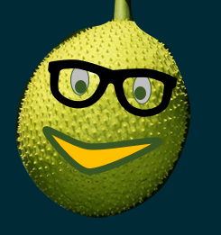

Kopi Break !

Slide 16
DNA Sequencing using Illumina & ONT

Slide 17
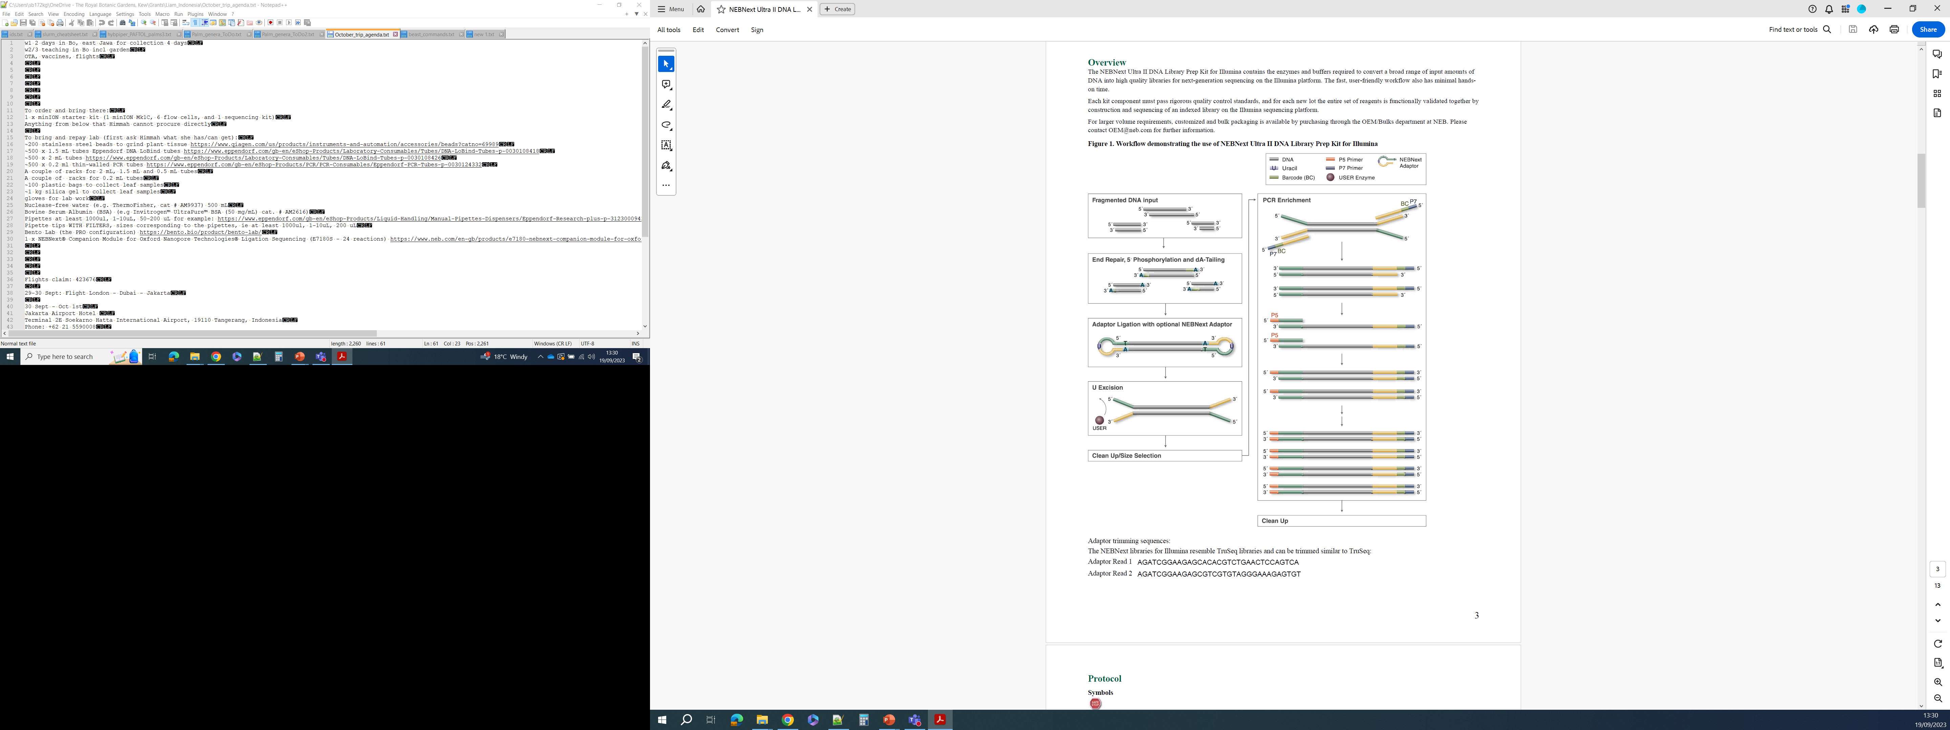
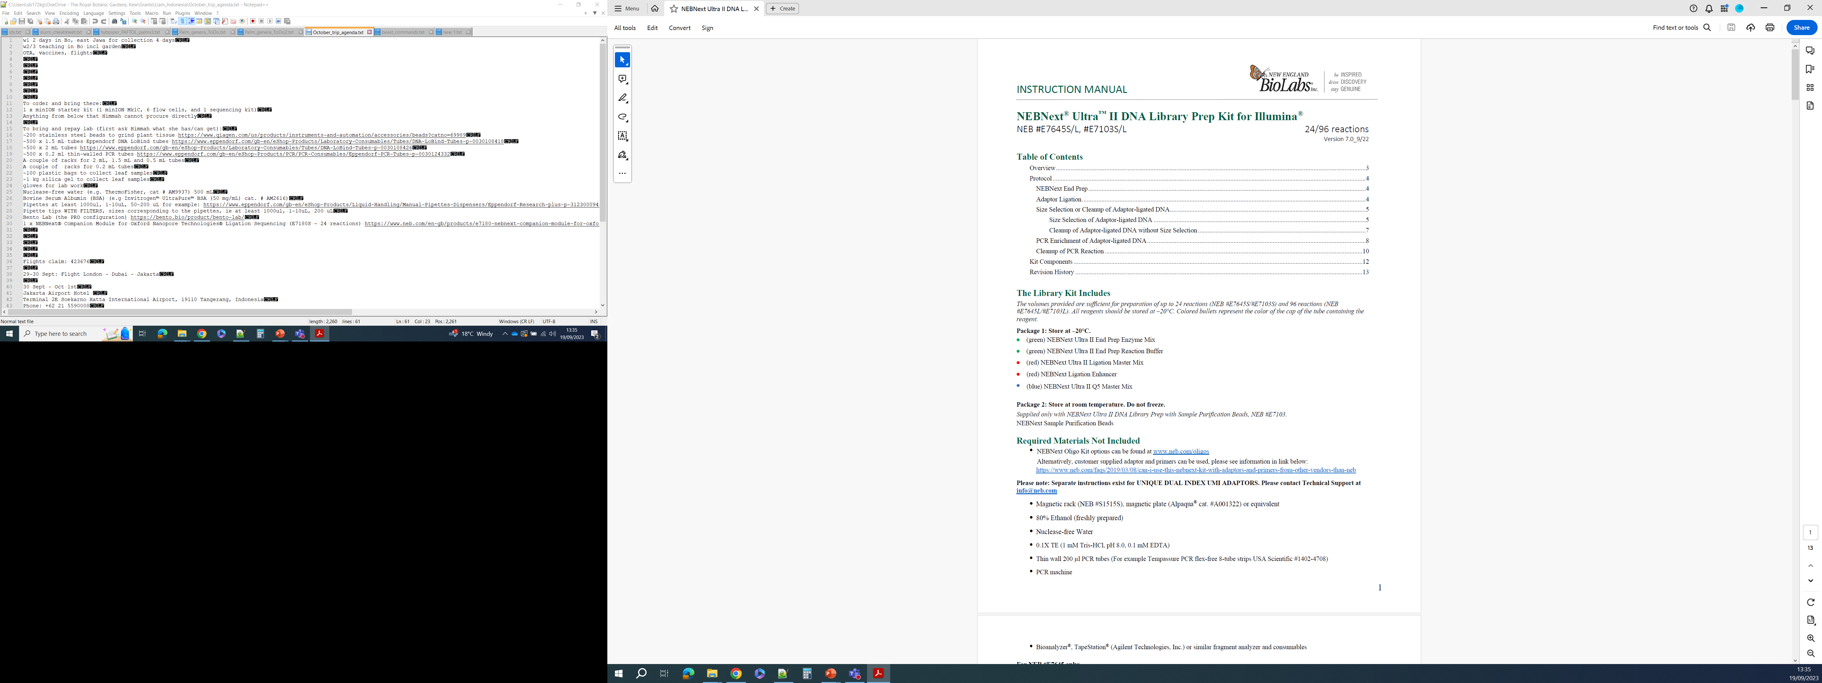
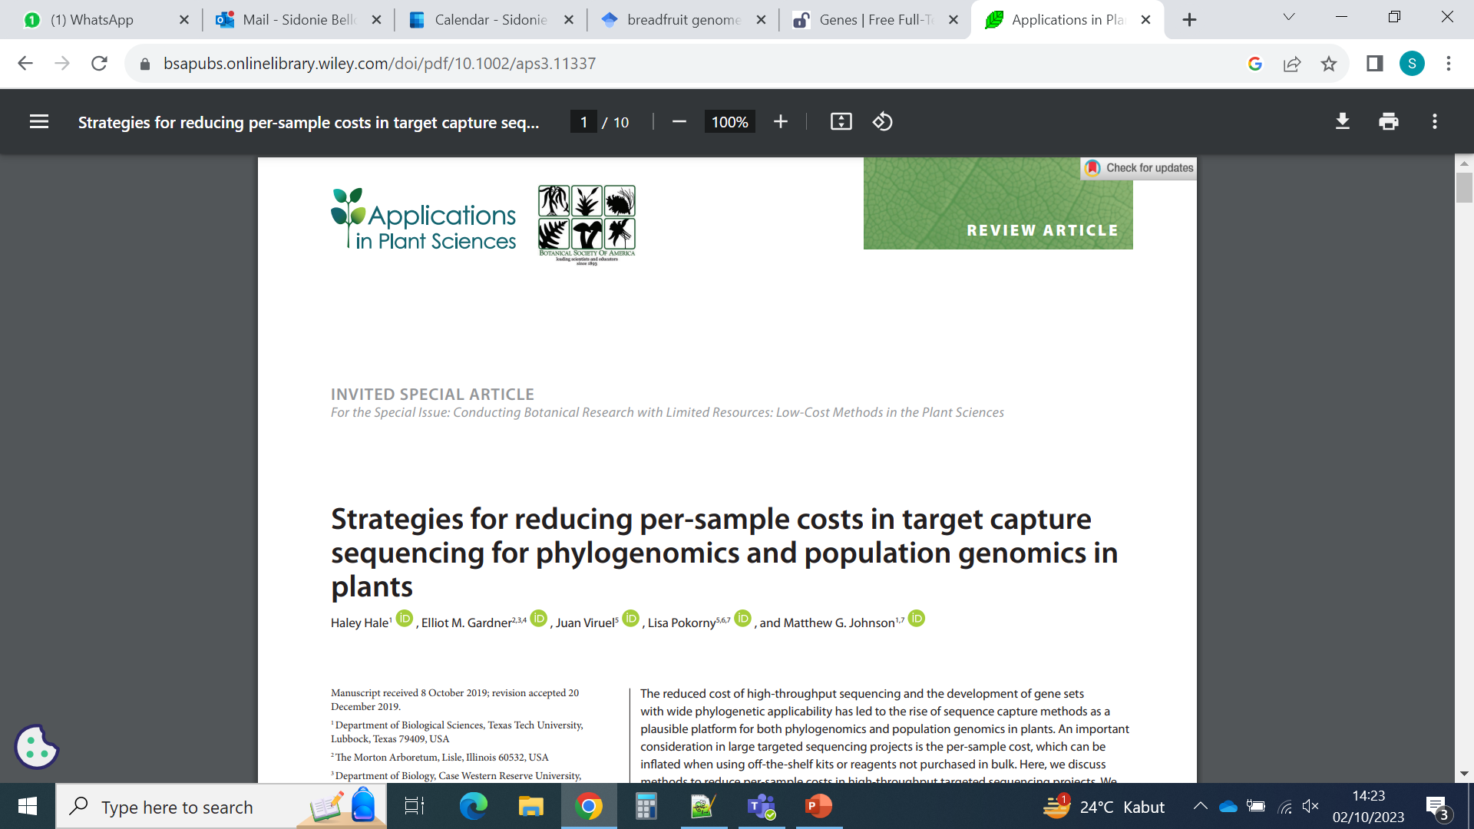
DNA preparation:
How to make a “DNA library”
Different kits exist
You can make custom ones
Costs can be saved at various stages

Slide 18
DNA library vocabulary
DNA library
Adapter: artificial DNA sequence used to attach the DNA fragment to further adapters/indexes or to attach it to the sequencing flow cell
Index or barcode: artificial DNA sequence usually 8 bp, attached to the DNA fragment. Different indexes or index pairs can be attached to different samples, so that samples can then be pooled together for cheaper sequencing. Because each read will be associated to the index, it is then possible to know what read comes from what sample.
Not the same “barcode” as for DNA barcoding!
Insert: DNA fragment
Library: DNA fragments with adapters (and indexes when used) attached to them
Primer 7
Adapter
Adapter
Primer 5
Barcode
= index
Adapter
Insert
Adapter

Slide 19
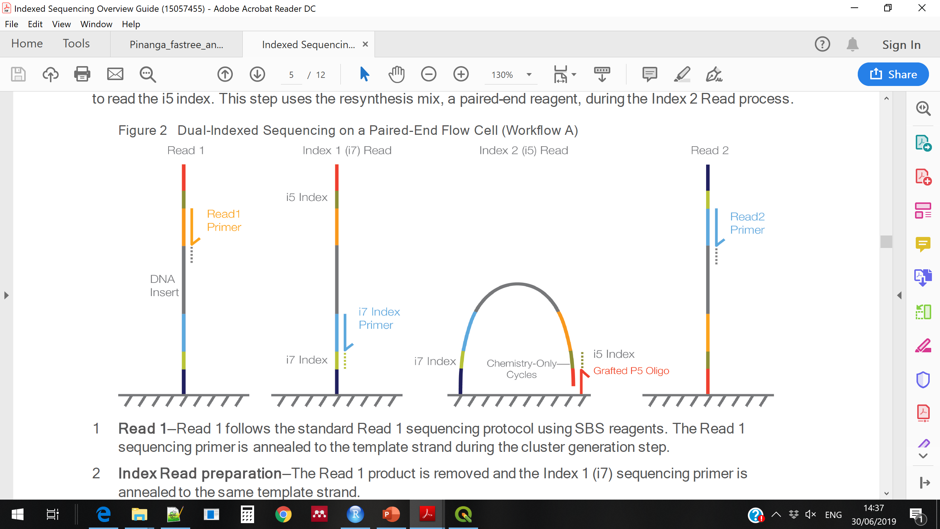
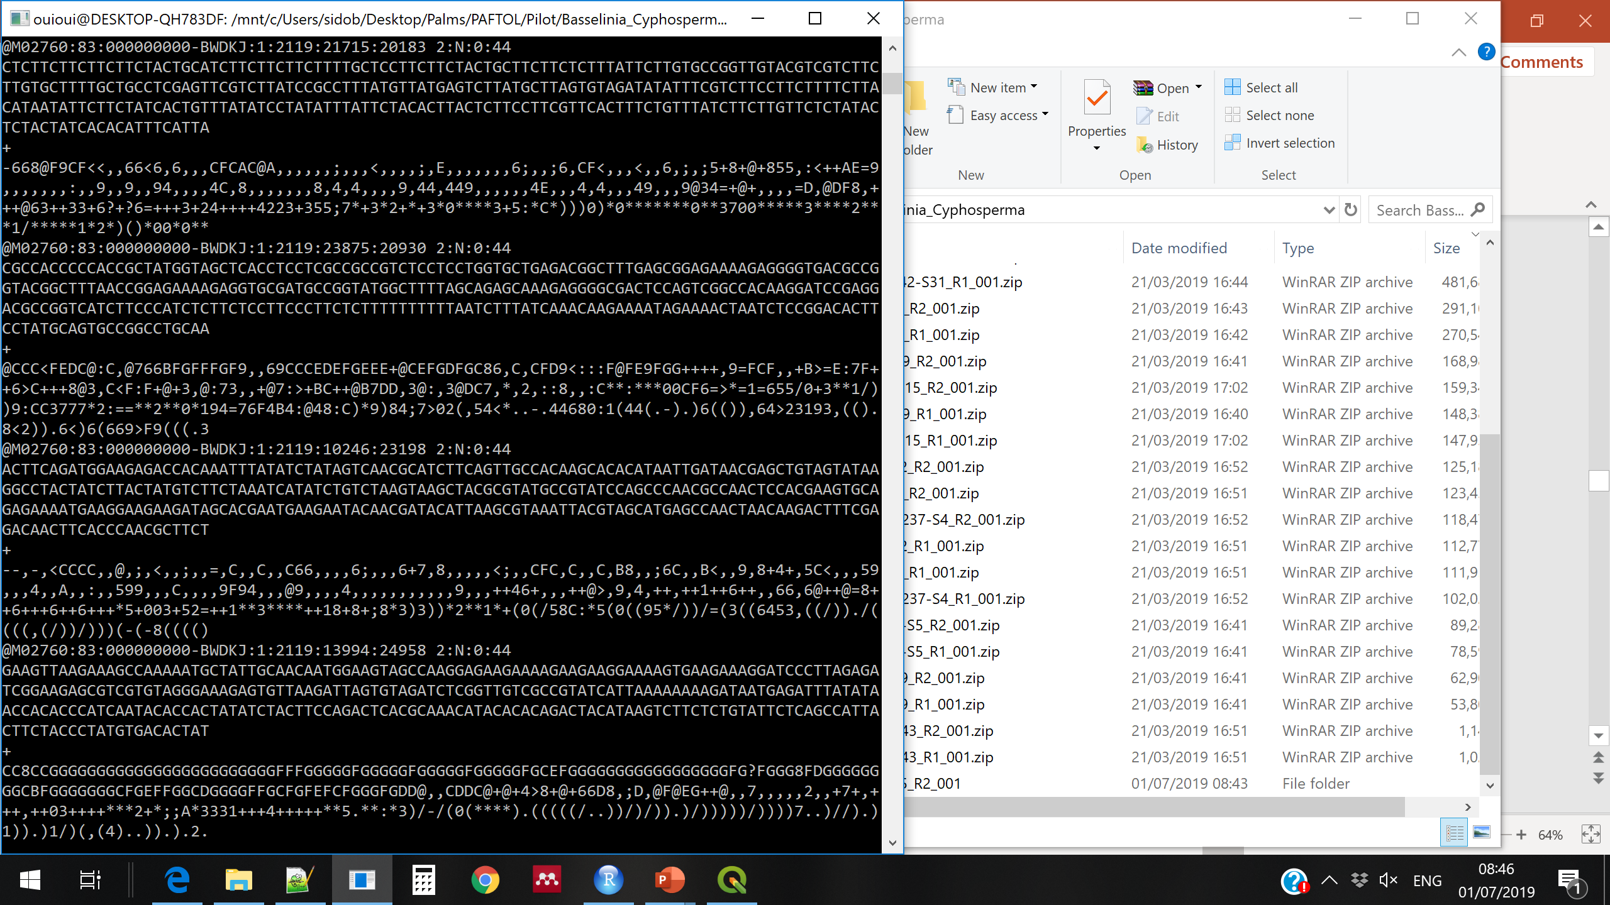
Illumina sequencing
(a bit different depending on the machine)
Millions of DNA fragments are attached to a “flow cell”
For each fragment, the complementary strand is synthesised
And the added nucleotides are “read” in real time
Producing a file with the DNA read and reading quality for each nucleotide →
© Adapted from Galaxy Training Network, Cormier, Leroi et al., 2023, licensed under Creative Commons Attribution 4.0 International License

Slide 20
Exercise: moving around & file manipulations
Go to your Desktop
Create a directory with the name of your choice
Create a file called as you wish, containing the word of your choice (ask Google!)
Move that file in the new directory that you created
List the files existing in that directory
Go to that directory
Write five more words into the file you created, each on a separate line
Print the three first lines of this file into a new file
Get out of the directory
Remove the first file you created (wait for instructor approval!)
Remove the whole directory (wait for instructor approval!)

Slide 21
Solutions: moving around & file manipulations
Go to your Desktop
cd /user/Desktop
Create a directory with the name of your choice
mkdir mydir
Create a file called as you wish, containing the word of your choice (ask Google!)
echo “sukun” > file1.txt
Move that file in the new directory that you created
mv file1.txt mydir
List the files existing in that directory
ls mydir
Go to that directory
cd mydir
Write five more words into the file you created, each on a separate line
echo “I\n” “love\n” “unix\n” “command\n” “line” >> file1.txt
Print the three first lines of this file into a new file
head -3 file2.txt
Get out of the directory
cd ../
Remove the first file you created (wait for instructor approval!)
rm mydir/file1.txt
Remove the whole directory (wait for instructor approval!)
rm -r mydir

Slide 22
More unix practice
Following online tutorials will help you understanding linux better and become familiar with main commands
Here is a set of tutorials we encourage you to do:
http://www.ee.surrey.ac.uk/Teaching/Unix/ , or if not working:
www.eecs.yorku.ca/course_archive/2-19-20/W/2031M/posts/UnixIntroduction2019.pdf
Or just google “York university unix tutorial” and find the pdf
It becomes more complicated when you progress through the tutorials.
Don’t worry if some things remain unclear, you do not need to know everything to start bioinformatics.
Do at least Tutorials 1, 2 and 4, and have a look at Tutorials 5 and 6 if you have time.
This will provide you with opportunities to practice commands we saw before, and to learn a couple of new ones.
Take the time to read the text around the commands, it will help you to progress!

Slide 23

Makan Siang !

Slide 24
Let’s get set up before going on
Open 2 terminal windows side by side
In one window, go to Desktop and explore the “data” folder
In the other window, go to Desktop, and open a Gedit file
Write the following in it:
# Unix for loops
Save the file (keep it open), and call it “unix_commands.sh”

Slide 25
The loop, a great tool
For each file in the directory called “dir”, print “blabla” in a file called “file_list.txt”
for file in dir/*; do (echo “blabla” >> file_list.txt); done

Slide 26
The loop, a great tool
For each file in the directory called “dir”, print “blabla” in a file called “file_list.txt”
for file in dir/*; do (echo “blabla” >> file_list.txt); done
How the loop works:
First, “for file” creates a variable (like a box) named “file” that contains the name of the first object that is found in the directory
Then, the action in the brackets is performed
Then, a new variable named “file” is created, containing the name of the next object found in the directory
Then, the action in the brackets is performed again
Etc… until there are no more objects in the directory

Slide 27
The loop, a great tool
For each file in the directory called “dir”, print “blabla” in a file called “file_list.txt”
for file in dir/*; do (echo “blabla” >> file_list.txt); done
How the loop works:
First, “for file” creates a variable (like a box) named “file” that contains the name of the first object that is found in the directory
Then, the action in the brackets is performed
Then, a new variable named “file” is created, containing the name of the next object found in the directory
Then, the action in the brackets is performed again
Etc… until there are no more objects in the directory
If the action in the brackets has to be performed on the object, we call the variable including that object using the $ sign:
for file in dir/*; do (echo $file >> file_list.txt); done

Slide 28
The loop, a great tool
For each file in the directory called “dir”, print “blabla” in a file called “file_list.txt”
for file in dir/*; do (echo “blabla” >> file_list.txt); done
How the loop works:
First, “for file” creates a variable (like a box) named “file” that contains the name of the first object that is found in the directory
Then, the action in the brackets is performed
Then, a new variable named “file” is created, containing the name of the next object found in the directory
Then, the action in the brackets is performed again
Etc… until there are no more objects in the directory
If the action in the brackets has to be performed on the object, we call the variable including that object using the $ sign:
for file in dir/*; do (echo $file >> file_list.txt); done
Our variable could be called anything as long as it is first defined with “for”:
for sukun in dir/*; do (echo $sukun >> file_list.txt); done
But it is usually a good idea to keep it short and meaningful: f for files, d for directories, l for lines, etc…

Slide 29
Using wild cards (*) in loops
For unix, * means “any letter” or “anything” depending on the context:
For each file starting with the letter P in the directory called “data”, print the file name in a file called “file_list.txt”:
for file in data/P*; do (echo $file >> file_list.txt); done

Slide 30
Using wild cards (*) in loops
For unix, * means “any letter” or “anything” depending on the context:
For each file starting with the letter P in the directory called “data”, print the file name in a file called “file_list.txt”:
for file in data/P*; do (echo $file >> file_list.txt); done
For each file finishing by “.fastq” in the directory called “data”, print the file name in a file called “file_list.txt”
for file in data/*.fastq; do (echo $file >> file_list.txt); done

Slide 31
Using wild cards (*) in loops
For unix, * means “any letter” or “anything” depending on the context:
For each file starting with the letter P in the directory called “data”, print the file name in a file called “file_list.txt”:
for file in data/P*; do (echo $file >> file_list.txt); done
For each file finishing by “.fastq” in the directory called “data”, print the file name in a file called “file_list.txt”
for file in data/*.fastq; do (echo $file >> file_list.txt); done
For each file starting with P and finishing by “.fastq” in the directory called “data”, print the file name in a file called “file_list.txt”
for file in data/P*.fastq; do (echo $file >> file_list.txt); done

Slide 32
Using wild cards (*) in loops
For unix, * means “any letter” or “anything” depending on the context:
For each file starting with the letter P in the directory called “data”, print the file name in a file called “file_list.txt”:
for file in data/P*; do (echo $file >> file_list.txt); done
For each file finishing by “.fastq” in the directory called “data”, print the file name in a file called “file_list.txt”
for file in data/*.fastq; do (echo $file >> file_list.txt); done
For each file starting with P and finishing by “.fastq” in the directory called “data”, print the file name in a file called “file_list.txt”
for file in data/P*.fastq; do (echo $file >> file_list.txt); done
List all files starting with the letter P:
ls P*

Slide 33
Using wild cards (*) in loops
For unix, * means “any letter” or “anything” depending on the context:
For each file starting with the letter P in the directory called “data”, print the file name in a file called “file_list.txt”:
for file in data/P*; do (echo $file >> file_list.txt); done
For each file finishing by “.fastq” in the directory called “data”, print the file name in a file called “file_list.txt”
for file in data/*.fastq; do (echo $file >> file_list.txt); done
For each file starting with P and finishing by “.fastq” in the directory called “data”, print the file name in a file called “file_list.txt”
for file in data/P*.fastq; do (echo $file >> file_list.txt); done
List all files starting with the letter P:
ls P*
For each file starting with the letter P in the directory called “data”, print the file name in a file called “file_list.txt”
but omit the “.fastq” extension and instead add “_blabla” to the file name
for file in data/P*; do (echo ${file/.fastq}_blabla >> file_list.txt); done

Slide 34
Exercise: write a “for loop”
Go to your data directory
Write a loop to do the following:
For each file containing “R1” in their name, list the file name in a file called “file_names.txt”

Slide 35
Exercise: write a “for loop”
Go to your data directory
cd data
Write a loop to do the following:
For each file containing “R1” in their name, list the file name in a file called “file_names.txt”
for f in *R1*; do (echo $f >> file_list.txt); done

Slide 36
Kopi Break !

Slide 37
Write a loop in 9 steps
Write the loop structure (for instance in nano/Gedit). In the next steps, you will complete it.
for in ; do (); done
2. What will be the output of the loop? A file? Multiple files? Something printed to the screen? Something else?
3. Based on your answer in 2, decide if you should specify a name for the output, and if yes, add it to the loop
for in ; do (>> file_list.txt); done
4. What will be the content of the output: A list of names? A list of values? A set of files with DNA data inside? (draw it!)
5. What should the loop do to generate the output? Iterate through files in a directory? Iterate through lines in a file?...
6. Based on your answer in 5, modify the beginning of the loop so that the computer can find the elements to iterate through
for file in data/P*; do (>> file_list.txt); done
7. What should be the action(s) performed at each iteration? On what should the action(s) be performed?
Should it be performed on a variable defined in step 6? What should be done with the element contained in the variable?
8. Based on your answer in 7, provide the command to perform the action(s):
for file in data/P*; do (echo ${file/.fastq}_blabla >> file_list.txt); done
9. Read the command: does it make sense? Are you in the right directory to run it? If yes, try it, and learn from the errors ☺

Slide 38
Exercise: write another “for loop”
Go to your data directory
Write a loop to do the following:
For each file containing “R1” in their name, list the file name in a file called “file_names.txt”, but remove the part of the name that is after R1

Slide 39
Exercise: write another “for loop”
Go to your data directory
cd data
2. Write a loop to do the following:
For each file containing “R1” in their name, list the file name in a file called “file_names.txt”, but remove the part of the name that is after R1
for f in *R1*; do (echo ${f/R1*}R1 >> file_list.txt); done

Slide 40
Exercise: write yet another “for loop”
Go to your data directory
Write a loop to do the following:
For each file containing “R1” in their name, list the file name in a file called “file_names.txt”, but remove the part of the name that is after R1, and replace it by “_blabla.fastq”

Slide 41
Exercise: write yet another “for loop”
Go to your data directory
cd data
3. Write a loop to do the following:
For each file containing “R1” in their name, list the file name in a file called “file_names.txt”, but remove the part of the name that is after R1, and replace it by “_blabla.fastq”
for f in *R1*; do (echo ${f/R1*}_blabla >> file_list.txt); done

Slide 42
More unix practice
Following online tutorials will help you understanding linux better and become familiar with main commands
Here is a set of tutorials we encourage you to do:
http://www.ee.surrey.ac.uk/Teaching/Unix/
It becomes more complicated when you progress through the tutorials.
Don’t worry if some things remain unclear, you do not need to know everything to start bioinformatics.
Do at least Tutorials 1, 2 and 4, and have a look at Tutorials 5 and 6 if you have time.
This will provide you with opportunities to practice commands we saw before, and to learn a couple of new ones.
Take the time to read the text around the commands, it will help you to progress!

